Slide 1

WEEK 3
CARBON CAPTURE AND STORAGE
Lecture 2

Slide 2

TOPIC OUTLINE
Storage of CO2

Slide 3
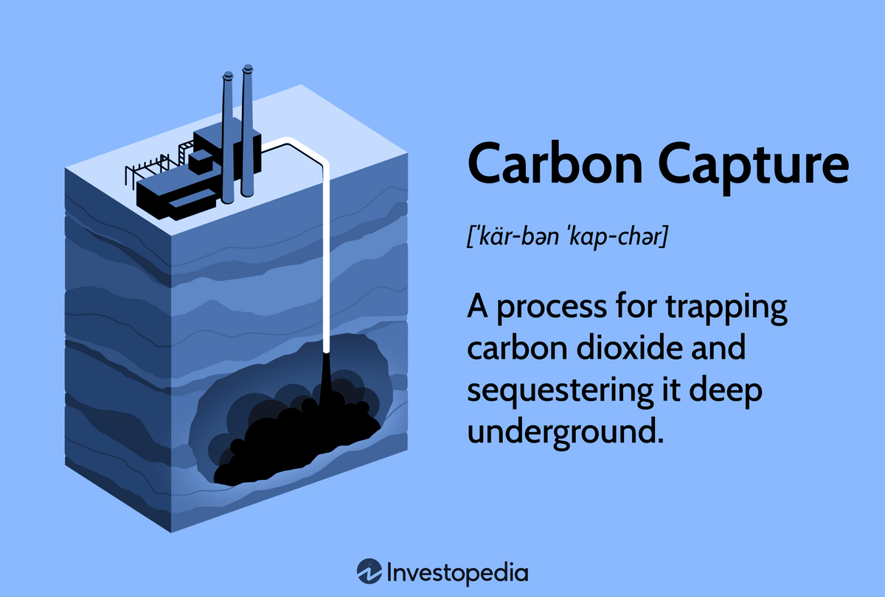
INTRODUCTION
The last but not least step in the CCS process is to store it safely underground. This can be achieved by finding deep geological formations that can be monitored and controlled for thousands of years.
Natural accumulations of virtually pure CO2 can be found all over the planet in a wide range of geological settings: particularly in sedimentary basins, intra-plate volcanic regions and in faulted areas, or in dormant volcanic structures. Natural gas and oil reservoirs have demonstrated that a great many formations are capable of storing gas for millions of years.

Slide 4
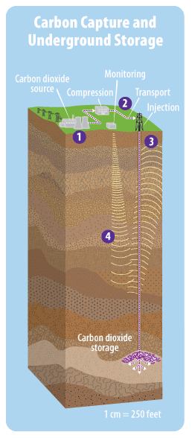
INTRODUCTION
Geological carbon storage involves capturing CO₂ emissions from industrial sources and injecting them into deep underground rock formations for long-term storage. This method is a crucial part of CCS strategies aimed at mitigating climate change by reducing atmospheric CO₂ levels.
To store CO₂ geologically, it is compressed to a supercritical state, where it behaves like a dense fluid. This typically occurs at depths of about 800 meters or more, where the geothermal gradient ensures the CO₂ reaches the necessary density.

Slide 5
INTRODUCTION
CO₂ storage is feasible in various geological settings within sedimentary basins, including:
Oil fields
Depleted gas fields
Deep coal seams
Saline formations
CO₂ can be stored both onshore and offshore. Offshore storage sites are accessed via pipelines from the shore or offshore platforms. Suitable offshore sites include the continental shelf and adjacent deep-marine sedimentary basins. However, abyssal deep ocean floor sediments are generally too thin and impermeable for effective storage.

Slide 6
INTRODUCTION
The principles of injecting fluids into the deep subsurface are well established, with many countries having regulations governing such activities. Fluids have been injected on a large scale for various purposes, including waste disposal, enhanced oil recovery, and natural gas storage. Although CO₂ injection has primarily been on a smaller scale, large-scale injection would be necessary to significantly reduce emissions from stationary sources.
It is also important to know how securely and for how long stored CO2 will be retained – for decades, centuries, millennia or for geological time? To assure public safety, storage sites must be designed and operated to minimize the possibility of leakage. Consequently, potential leakage pathways must be identified and procedures must be established, to set appropriate design and operational standards as well as monitoring, measurement and verification requirements

Slide 7
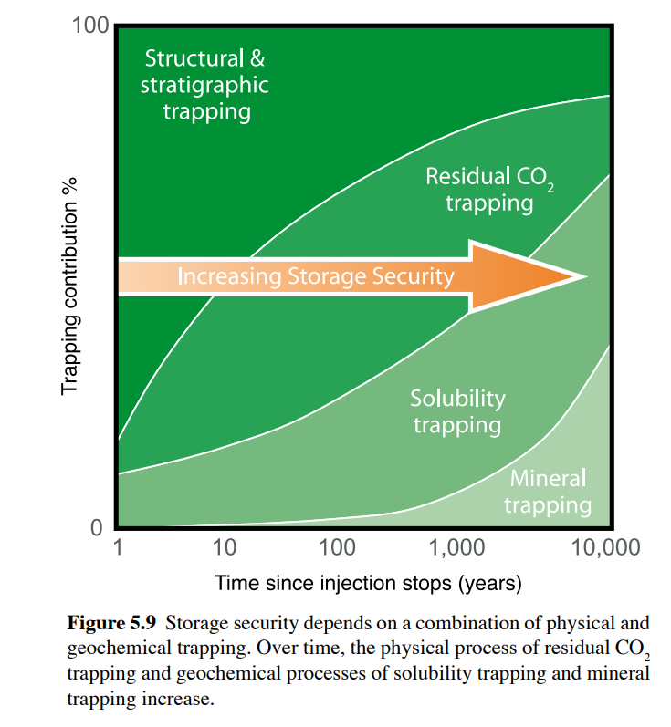
MECHANISM OF CO2 STORAGE-
The effectiveness of geological storage depends on a combination of physical and geochemical trapping mechanisms (Figure 5.9). The most effective storage sites are those where CO2 is immobile because it is trapped permanently under a thick, low-permeability seal or is converted to solid minerals or is adsorbed on the surfaces of coal micropores or through a combination of physical and chemical trapping mechanisms

Slide 8
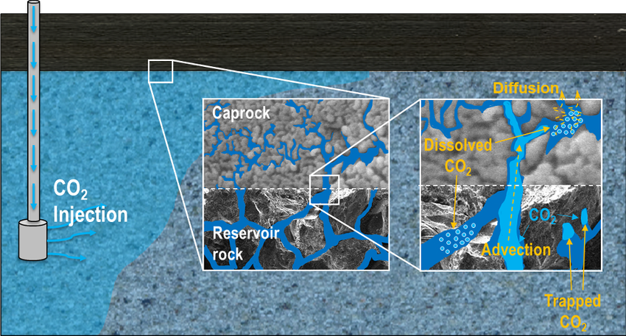
MECHANISM OF CO2 STORAGE-
Physical trapping: stratigraphic and structural-
The initial method for storing CO₂ in geological formations relies on physical trapping beneath low-permeability caprocks, such as shale or salt beds. These caprocks prevent CO₂ from escaping. Structural and stratigraphic traps within sedimentary basins, which contain saline water, oil, and gas, are suitable for CO₂ storage. However, care must be taken to avoid exceeding the allowable pressure to prevent fracturing the caprock or reactivating faults, which could compromise storage integrity.

Slide 9
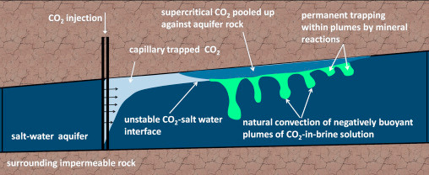
MECHANISM OF CO2 STORAGE-
Physical trapping: hydrodynamic
Hydrodynamic trapping occurs in saline formations without closed traps, where fluids migrate slowly over long distances. Injected CO₂ displaces saline water and moves upward due to its lower density. It then continues as a separate phase until trapped as residual CO₂ saturation or in local structural or stratigraphic traps. Over time, significant amounts of CO₂ dissolve in formation water and migrate with groundwater. In extensive formations, the journey from injection site to surface can take millions of years, ensuring long-term storage

Slide 10
MECHANISM OF CO2 STORAGE-
Geochemical Trapping :Solubility Trapping: CO₂ dissolves in formation water, eliminating buoyant forces. This process is fast initially but slows down as saturation occurs.
Geochemical Trapping: Mineral Trapping: Dissolved CO₂ reacts with rock minerals, forming stable carbonate minerals over thousands of years. This is the most permanent form of CO₂ storage, enhancing long-term security.

Slide 11
TYPES OF GEOLOGICAL FORMATIONS SUITABLE FOR STORAGE
Depleted Oil and Gas Reservoirs
Deep Saline Aquifiers
Unmineable Coal Seams
A)Depleted Oil and Gas Reservoirs-
Abandoned oil and gas fields:
Depleted oil and gas reservoirs are ideal for CO₂ storage due to their proven long-term integrity, extensive geological characterization, and existing infrastructure. The geological structures that held hydrocarbons for millions of years are well-studied, and computer models can predict CO₂ behavior in these reservoirs. Existing wells and infrastructure can be repurposed for CO₂ storage. However, the integrity of old wells must be assessed, and caprock pressure must be managed to avoid damage. Shallow reservoirs (<800 m) have lower capacity and may face technical challenges due to CO₂ being in the gas phase.

Slide 12
TYPES OF GEOLOGICAL FORMATIONS SUITABLE FOR STORAGE
Enhanced oil recovery(EOR):
EOR is mainly achieved by injecting different substances into the oil reservoir, i.e. gas injection, chemical injection or microbial injection. The most commonly used option for EOR is the injection of gas. Oil displacement by CO2 injection relies on the phase behaviour of the mixtures of the gas and the crude oil, which depends on reservoir temperature, pressure and the composition of the crude oil. In these applications, more than half and up to two thirds of the injected CO2 returns with the produced oil and is usually re-injected into the reservoir to minimise operating costs. The remainder is trapped in the oil reservoir by various means.

Slide 13
TYPES OF GEOLOGICAL FORMATIONS SUITABLE FOR STORAGE
B) Saline Formation
Saline formations are deep sedimentary rocks saturated with formation waters or brines containing high concentrations of dissolved salts. These formations are widespread and contain enormous quantities of water, but are unsuitable for agriculture or human consumption. Saline brines are used locally by the chemical industry and formation waters of varying salinity are used in health spas and for producing low-enthalpy geothermal energy. Because the use of geothermal energy is likely to increase, potential geothermal areas may not be suitable for CO2 storage.

Slide 14
TYPES OF GEOLOGICAL FORMATIONS SUITABLE FOR STORAGE
It has been suggested that combined geological storage and geothermal energy may be feasible, but regions with good geothermal energy potential are generally less favourable for CO2 geological storage because of the high degree of faulting and fracturing and the sharp increase of temperature with depth. In very arid regions, deep saline formations may be considered for future water desalinization.
The CO2 is injected into poorly cemented sands about 800– 1000 m below the sea floor. The sandstone contains secondary thin shale or clay layers, which influence the internal movement of injected CO2 . The overlying primary seal is an extensive thick shale or clay layer. The saline formation into which CO2 is injected has a very large storage capacity.

Slide 15
TYPES OF GEOLOGICAL FORMATIONS SUITABLE FOR STORAGE
C) Unmineable Coal Seams
Coal seams offer a unique CO₂ storage option due to their structure of cleats and micropores, which can adsorb gases. Coal has a higher affinity for CO₂ than methane, making it suitable for displacing methane in coalbed methane (CBM) recovery. However, the process involves challenges like coal plasticization and swelling, which reduce permeability and injectivity. High injection pressures may counteract these effects. Successful CO₂ injection projects in coal seams, such as the Allison Project, demonstrate the potential for enhanced methane recovery while storing CO₂. Nonetheless, coal permeability, which decreases with depth, remains a critical factor in site selection.
Other geological media and/or structures – including basalts, oil or gas shale, salt caverns and abandoned mines – may locally provide niche options for geological storage of CO2 .

Slide 16

Site Selection
Criteria
CAPACITY
The selected site must have sufficient pore space to store the required volume of CO₂. This involves assessing the thickness and extent of the porous rock formations.
INTEGRITY
The site must have an impermeable caprock to ensure that CO₂ remains trapped. The integrity of the caprock is crucial to prevent CO₂ from migrating to the surface..
INJECTIVITY
The rock formation must allow CO₂ to be injected at a practical rate. This involves understanding the permeability and porosity of the rock.
MONITORING AND VERIFICATION
Effective monitoring and verification methods must be in place to track CO₂ migration

Slide 17
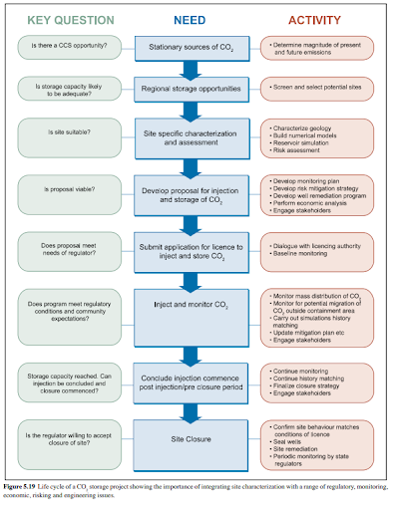

Slide 18
Case Studies
WEYBURN-MIDALE PROJECT (CANADA):
SLEIPNER PROJECT (NORWAY):
This project uses CO₂ for EOR and has an extensive monitoring program to study CO₂ behavior and storage security. It has demonstrated the dual benefits of CO₂ storage and enhanced oil recovery.
The Sleipner Project is the world’s first commercial CO₂ storage project, injecting CO₂ into a saline aquifer in the North Sea since 1996. It has successfully stored millions of tons of CO₂ and provided valuable data on CO₂ behavior in the subsurface.
GORGON PROJECT (AUSTRALIA):
One of the largest CCS projects globally, it involves injecting CO₂ into a deep saline aquifer. The project aims to store up to 4 million tons of CO₂ per year and includes comprehensive monitoring and verification programs.

Slide 19
In projects like these special care needs to be taken in regard to the Risk assessment and management for CO₂ storage. It involves identifying potential leakage pathways, such as faults, fractures, and abandoned wells, and evaluating environmental impacts on groundwater, ecosystems, and human health through modeling and monitoring.
Adherence to regulatory compliance and engaging with the public for transparency are also some crucial aspects.
Monitoring techniques like seismic surveys, well logging, and surface monitoring help track CO₂ movement and detect leaks.
Long-term storage security relies on promoting geochemical reactions, managing pressure, and having adaptive management plans.
Some of the challenges which are faced by Geological Storage include reducing costs, advancing technology, developing robust regulations, and enhancing public acceptance.

